Slide 1
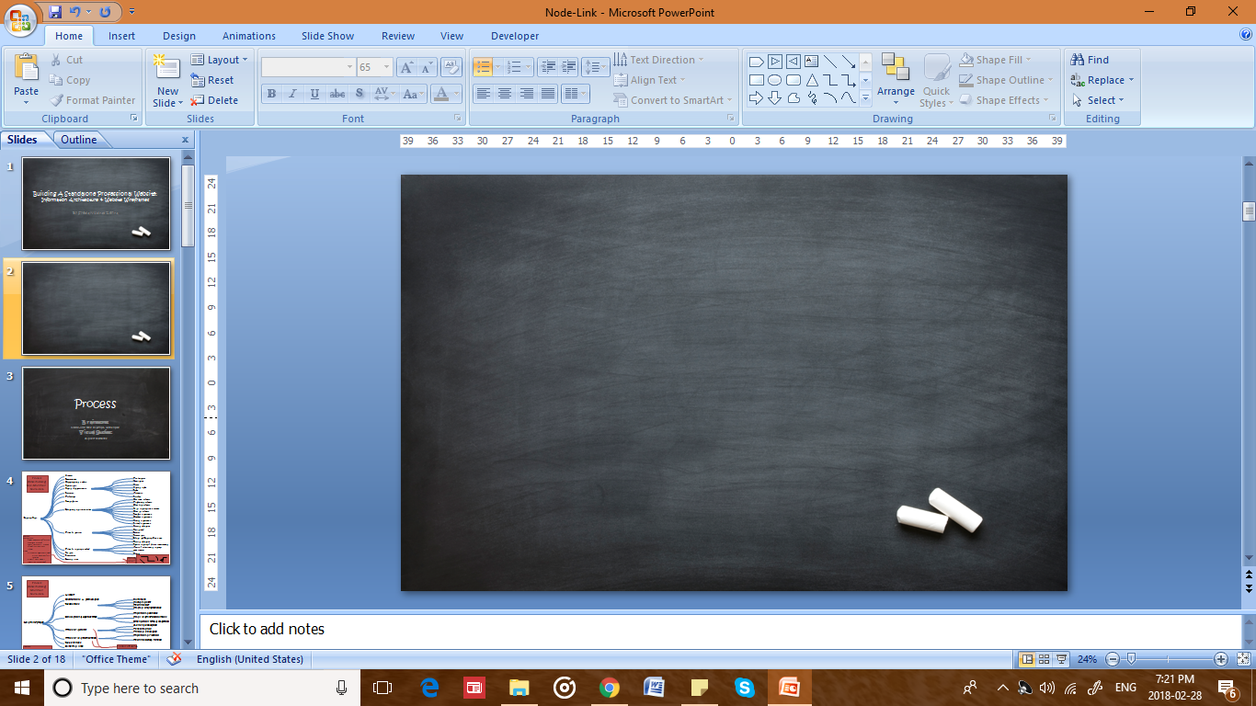
Building A Standalone Professional Website: Information Architecture & Website Wireframes
CCT260
Professor Elyse M. & Shanta N.
Thursday, 2PM - 5PM
Date: March 1st 2018
Assignment #1
Student Name: Syeda Nudrat Zehra
Student Number: 1003433965 (UTM); 991501216 (Sheridan)

Slide 2
Assignment Information
Webpage Title: Learning Space
Webpage Link: https://en.wikipedia.org/wiki/Learning_space

Slide 3
Node-Link
Tree Diagrams
Non – Modified Content
&
Modified Content

Slide 4
Node-link Tree Diagram
Non-modified Content
History
Institutions
Temperature
Organizational models
Ventilation
Significance
Views
Spatial characteristics
Natural light
Light
Furniture
Acoustics
Technology
Finishes
One room schools
Sustainability
Traditional schools
Open plan schools
Educational facilities types
Small learning communities
Open air schools
Portable classrooms
Learning Space
Outdoor classrooms
Virtual classrooms
Flipped classrooms
General education
Specialized
Types by activity
Lecture
Performance
Library and Learning Commons
Physical education
Passive learning / direct instructional
Types by learning method
Active / experiential learning
21st century
See also
Virtual
References
External links

Slide 5
Node-link Tree Diagram
Modified Content
Traditional schools
Institutions
Small learning communities
Interaction Virtual Classroom
Technology
Resources
Spatial characteristics
General education
Learning Space
Learning methods
Physical education
Traditional Method
Technological Method
Photo Gallery
About

Slide 6
Personas
Primary users in relation to the wireframe
The website affects the overall image and reputation of institutions which can lead to increased admissions. Having a good website is also very important for delivering a good user experience for its regular users, including teachers, students and parents.
Student Body
Schools prepare students to go out on their own and be successful in their lives.
Some students can visit the website to gain more knowledge about future opportunities. These students will be the next educators.
The website offers students to go through, a number of resources such as technological devices available. Students can also look over the learning methods tab, that offers various ways of learning.
Institutions & Teachers
Institutions can post about their new or updated programs onto the website.
Teachers can search for new job opportunities, exploring new fields of teaching and inform themselves of new resources available. The website also offers teachers to look over learning methods, and use these while teaching in class.
This website is designed to be conveniently used by schools and teachers to navigate around resources and institutions.
Parents
Parents often search for schools or institutions that can provide their children to study around a healthy and academically strong space.
If they find the website impossible to navigate, they might just leave the website and search for another school.
One of the global navigation label is “Gallery”, where parents can see how potential schools buildings or environment looks like, to give them an idea.
This website is designed in such a way that allows parents to explore around a list of schools and/or college/university. With clear navigations, parents will find the website accessible to use.

Slide 7
Wireframes
Homepage
&
Inner Content Page

Slide 8

Wireframe
(Homepage)
TITLE
(IMAGE)
(IMAGE)
Search Engine
NAVIGATION BAR
IMAGEs
(Slideshow)
Social Media Updates
CONTENT
Primary Footer Menus
Footer Navigation

Slide 9
Wireframe
(Inner Content Page)
TITLE
(IMAGE)
(IMAGE)
Search Engine
NAVIGATION BAR
Sub-title
Content
Primary Footer Menus
Footer Navigation

Slide 10
Graphic Design
Homepage
&
Inner Content Page

Slide 11
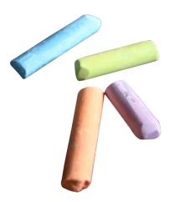
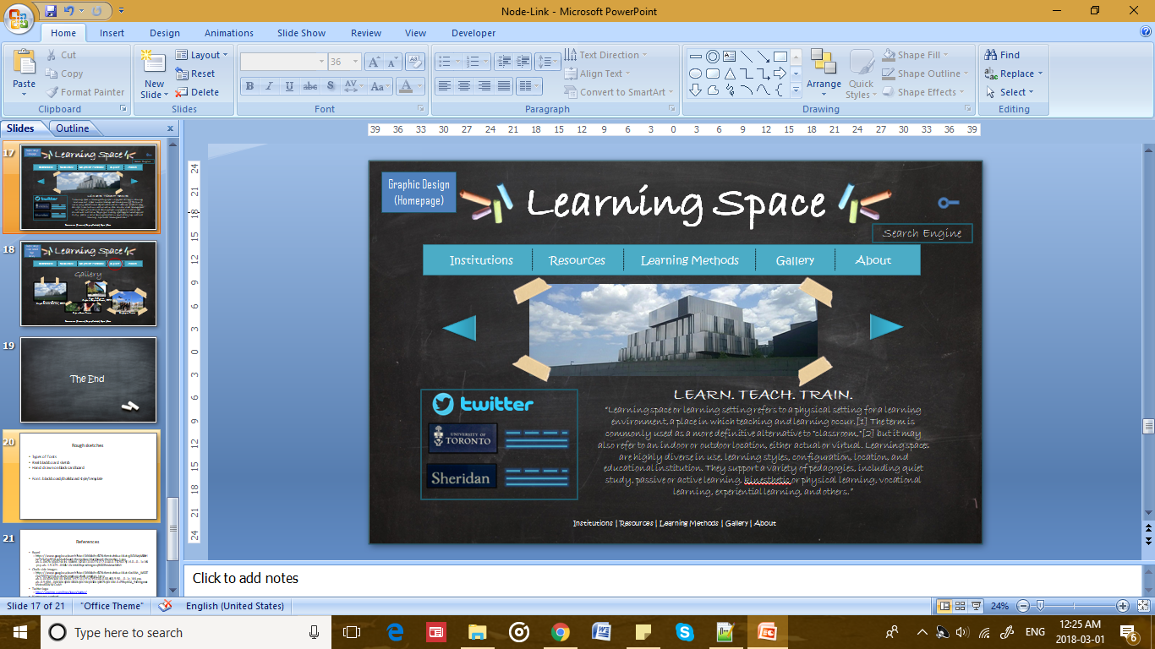

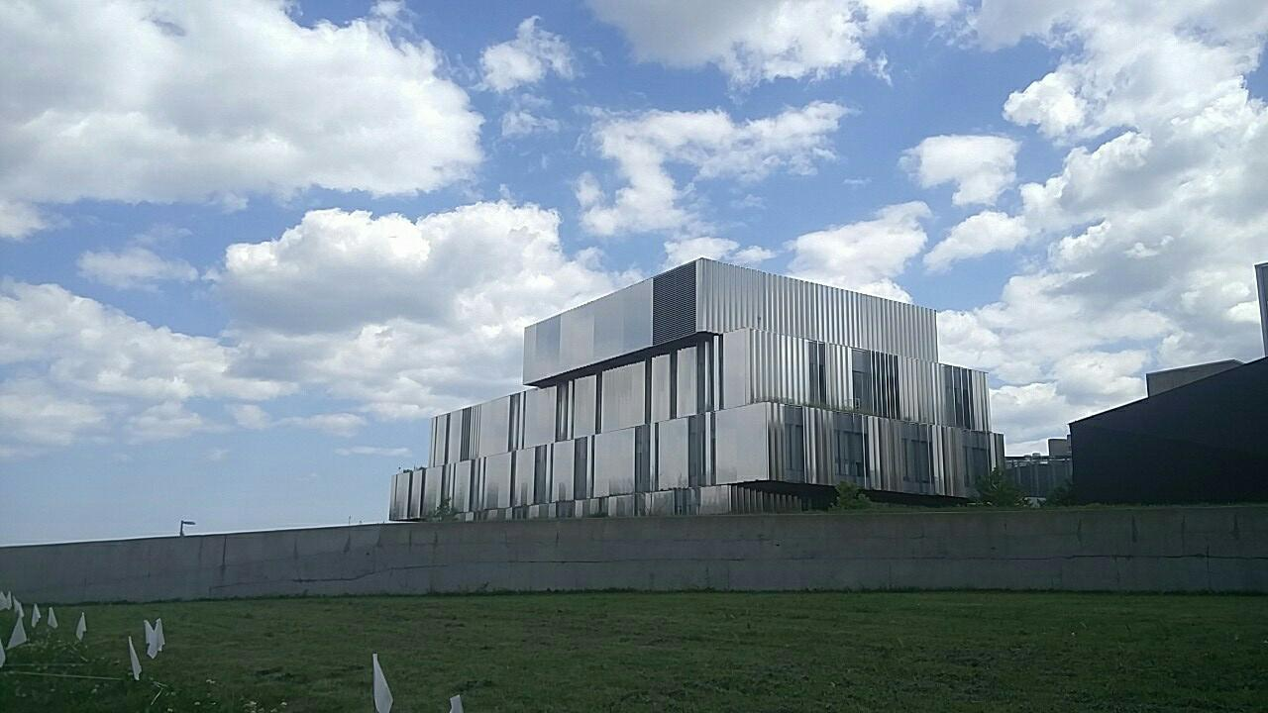




Graphic Design
(Homepage)
Learning Space
Search
Institutions
Resources
Learning Methods
Gallery
About
LEARN. TEACH. TRAIN.
“Learning space or learning setting refers to a physical setting for a learning environment, a place in which teaching and learning occur.[1] The term is commonly used as a more definitive alternative to "classroom,"[2] but it may also refer to an indoor or outdoor location, either actual or virtual. Learning spaces are highly diverse in use, learning styles, configuration, location, and educational institution. They support a variety of pedagogies, including quiet study, passive or active learning, kinesthetic or physical learning, vocational learning, experiential learning, and others.”
Institutions | Resources | Learning Methods | Gallery | About
Terms of Use:
“By using this site, you agree to the Terms of Use and Privacy Policy. Wikipedia® is a registered trademark of the Wikimedia Foundation, Inc., a non-profit organization.”

Slide 12




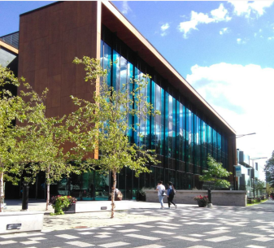


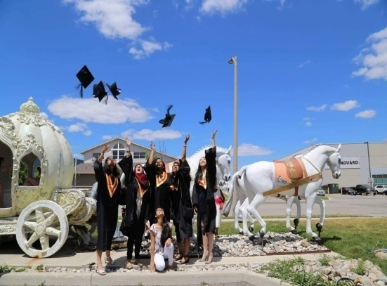


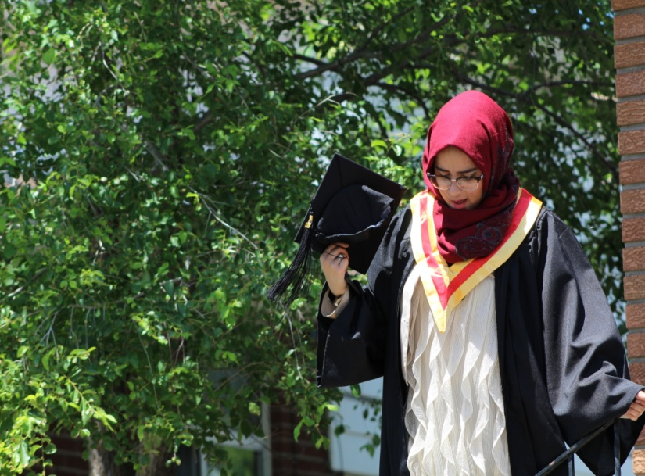


Graphic Design
(Inner Content Page)
Gallery
Learning Space
Search
Institutions
Resources
Learning Methods
Gallery
About
Gallery
Hazel McCallion
Academic Learning Centre, UTM
Terrence Donnelly
Health Sciences Complex, UTM
Cape & Gown Picture
Graduation Picture
Institutions | Resources | Learning Methods | Gallery | About
Terms of Use:
“By using this site, you agree to the Terms of Use and Privacy Policy. Wikipedia® is a registered trademark of the Wikimedia Foundation, Inc., a non-profit organization.”

Slide 13
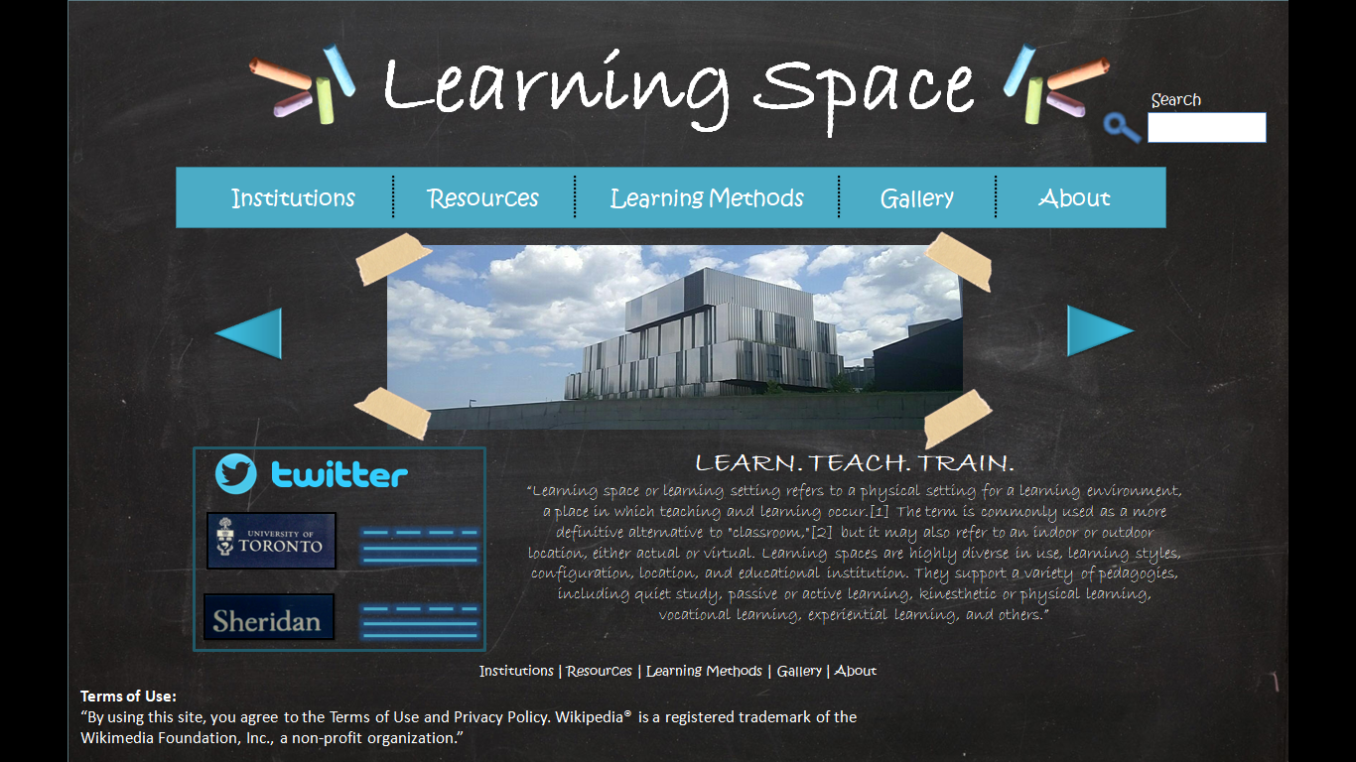
Navigation
Utility
Navigation
(Search Bar)
Structural
Navigation
(Global - Menul)
Associative
Navigation
(Footer –
Terms of Use)

Slide 14
Process
Brainstorm:
Node-line tree diagram, wireframe
Visual Studies:
Gallery pictures, graphic design

Slide 15
Process
(Brainstorming)
Rationale of choice:
I chose ‘learning space’ as my topic because I am able to relate with this idea more than any other. Learning space can be applied to several institutions, such as university or college. Being a University as well as a college student, I am able to understand the aspects better. Besides the relevance of the topic, the Wikipedia page also fulfils all the requirements that the project outline asks for, such as approximately 2000 words and contains more than eight content branches.
Resources
Consider official school/institution websites to get better idea of wireframe
For templates, consider professors hard-copy templates/backgrounds
Check phone for UTM/Sheridan pictures

Slide 16
Process
(Brainstorming)
Non-Modified Node-Link
History
Institutions
Temperature
Organizational models
Ventilation
Significance
Views
Spatial characteristics
Natural light
Light
Furniture
Acoustics
Technology
Finishes
Sustainability
One room schools
Traditional schools
Open plan schools
Educational facilities types
Small learning communities
Open air schools
Portable classrooms
Learning Space
Outdoor classrooms
Virtual classrooms
Flipped classrooms
General education
Specialized
Types by activity
Lecture
Side note:
Background:
White: whiteboard effect but too bright. Maybe?
Black: blackboard, *take pic of a BB from classroom. (DONE)
Lines
Curve or straigt or w/ arrows?
Curvy: looks nicer for a node-link
Colour?: black+white+ 1 colour- red, aqua or blue?
Performance
Library and Learning Commons
Physical education
Passive learning / direct instructional
Types by learning method
Active / experiential learning
21st century
See also
Virtual
References
External links
Which
one?

Slide 17
Process
(Brainstorming)
Modified
Node-Link
History
Institutions & Significance
Furniture
Sustainability
Resources
Technology
Spatial characteristics
Traditional schools
Educational facilities types
Small learning communities
Learning Space
Interaction Virtual Classroom
General education
Types by activity
Performance
Physical education
Traditional Method
Types by learning method
Technological Method
References
Side note:
Max 7
Add “photo gallery” in navigation
Include UTM pics as institution pictures
Or put these pictures on homepage as a slideshow
External links
Combine these two
Replace external links & references with “about”?

Slide 18
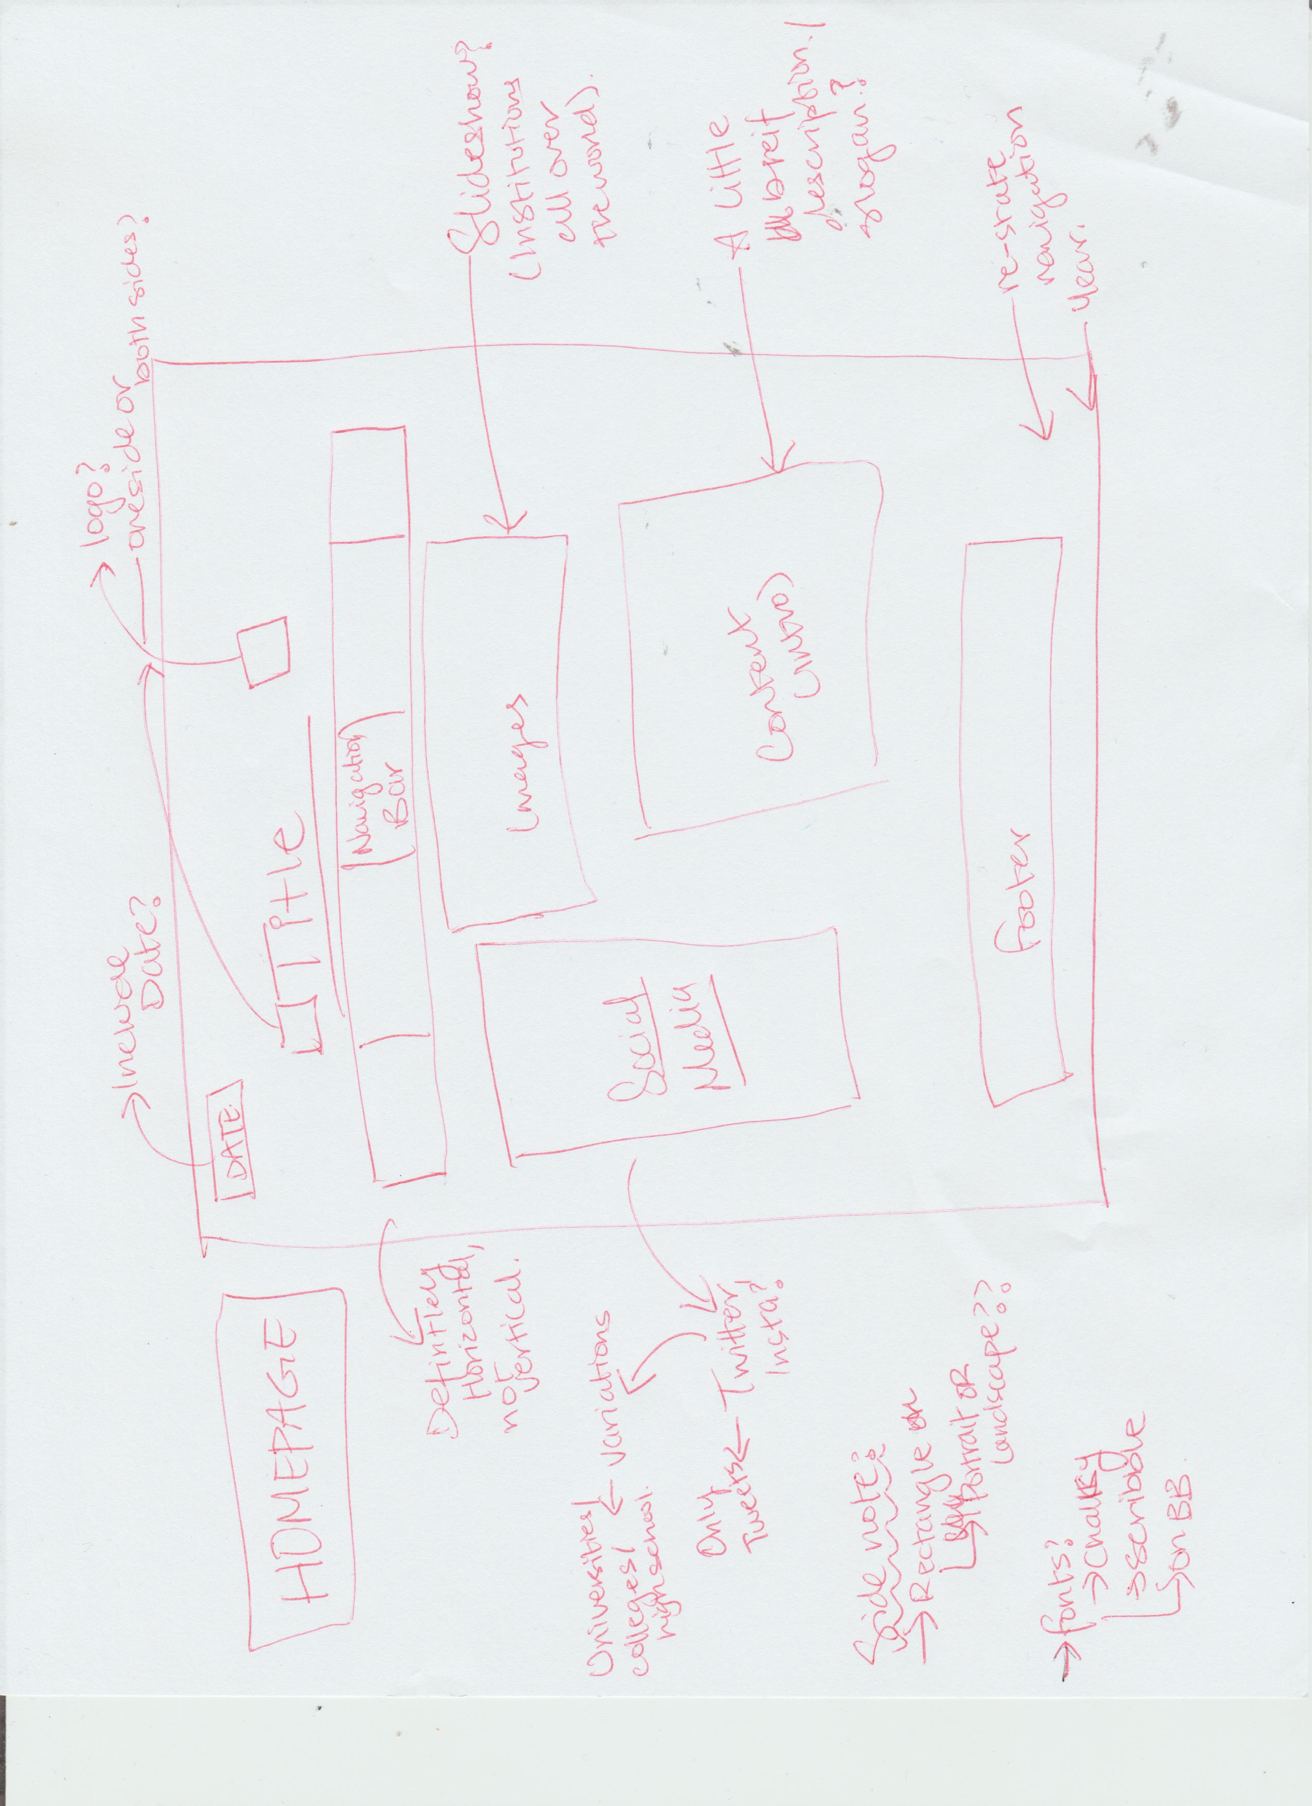
Process
(Brainstorming)
Wireframe - Hardcopy

Slide 19
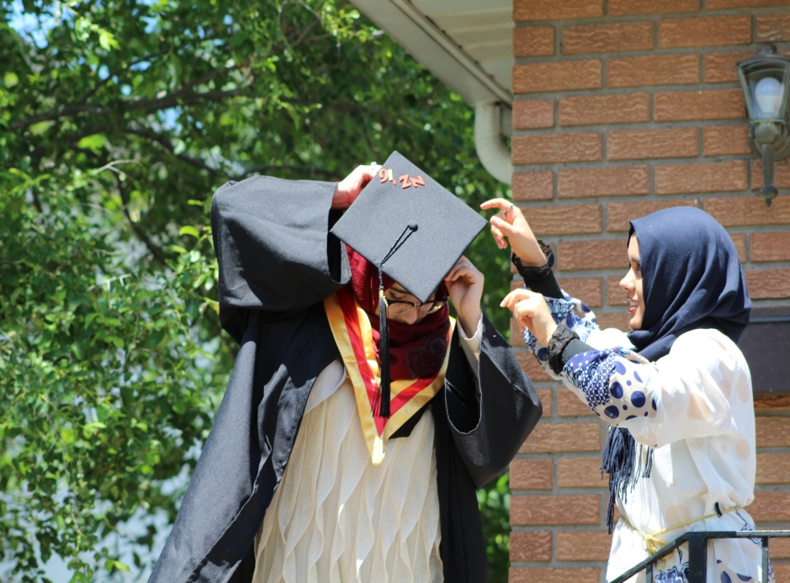

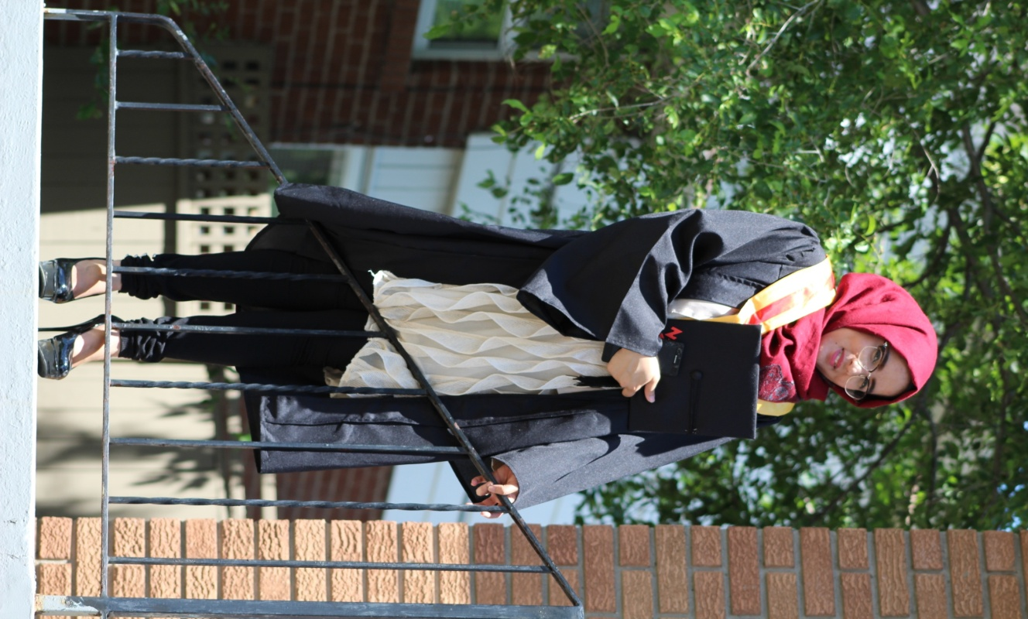

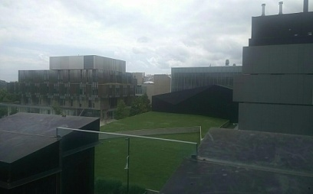

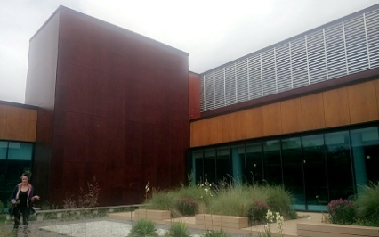


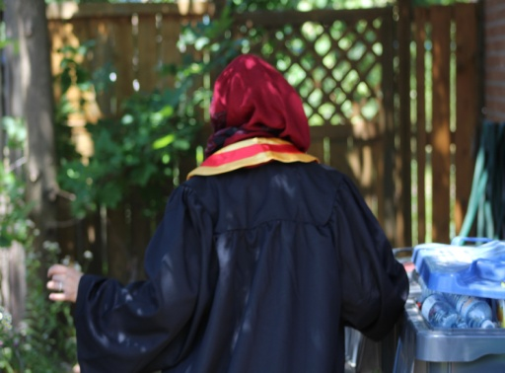
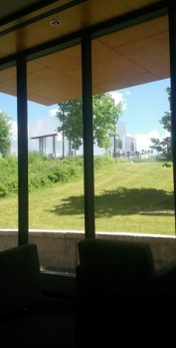

Process
(Visual Studies)
Gallery
Cropped & adjusted
Adjust colours, cut down sky area
Adjust the size, rest is good
INCLUDE IT
Adjust colours
Side note:
For photo gallery or homepage slideshow
Caption is a must- photographers name and location
Consider size of the picture
Has to be landscape
Have a combo of traditional and modern
Adjust brightness or contrast if needed
Zoomed and landscape
-Use this
Original but portrait
High school Graduation Pictures
University Pictures

Slide 20


Process
(Visual Studies)
Gallery
Fonts Suitable For Chalkboard Theme
Tapes For Gallery Images
Learning Space
Learning Space
Learning Space
Learning Space
Learning Space
Learning Space
Learning Space
Learning Space

Slide 21
References
Blackboard clipart powerpoint theme. (n.d.). Retrieved February 29, 2018,
from http://moziru.com/explore/Blackboard%20clipart%20powerpoint%20theme/
Learning space. (2018). En.wikipedia.org. Retrieved 1 March 2018, from https://en.wikipedia.org/wiki/Learning_space
Masking Tape five. (2018). enjolivure. Retrieved 29 February 2018, from https://enjolivure.wordpress.com/2012/07/01/misc/masking-tape-five-3/
PNG images: Twitter. (n.d.). Retrieved February 28, 2018, from http://pngimg.com/imgs/logos/twitter/
Tape Png - Freeiconspng. (2018). Freeiconspng.com. Retrieved 1 March 2018, from http://www.freeiconspng.com/images/tape-png
***Rest of the graphics (grad pictures + UTM pictures) were taken by me.
***Written content on graphic design homepage is quoted from Wikipedia.

